Slide 1
Channel Analysis:
Commercial Agency and Direct Policies
By Britt Orcutt

Slide 2
OVERVIEW
ANALYSIS
What are some of the key differences between volume in direct and agency policies?
Do we sell more of one channel of policy by state, risk type, or business type?
Is one type growing faster than the other?
AGENDA
Direct vs Agency
  PIFs
  Earned Premium
  Market
Breakdowns by Channel
  State
  Business Type
  Average Profit
Growth Opportunities

Slide 3
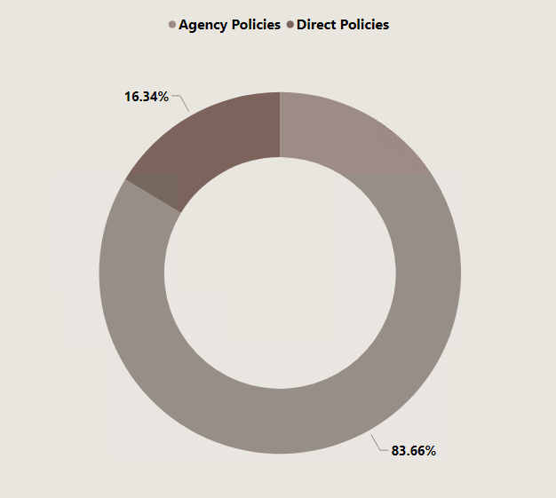
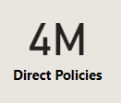
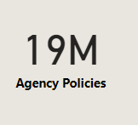
Policies in force by channel

Slide 4
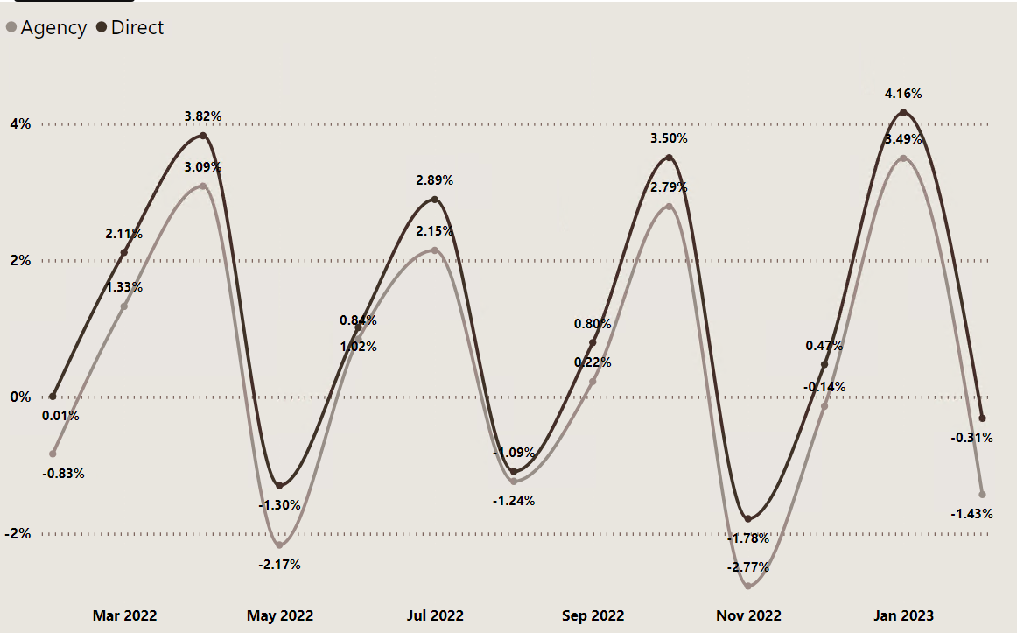
Policies in force growth percentage

Slide 5
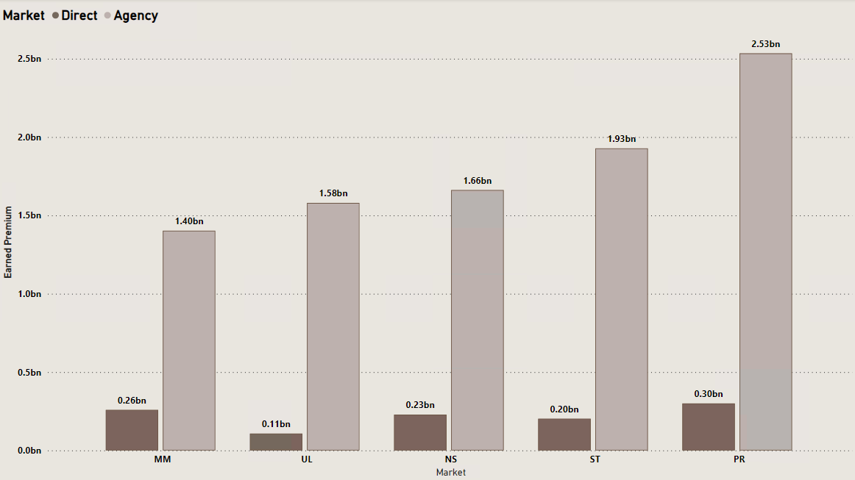
Channel Breakdown by Market

Slide 6
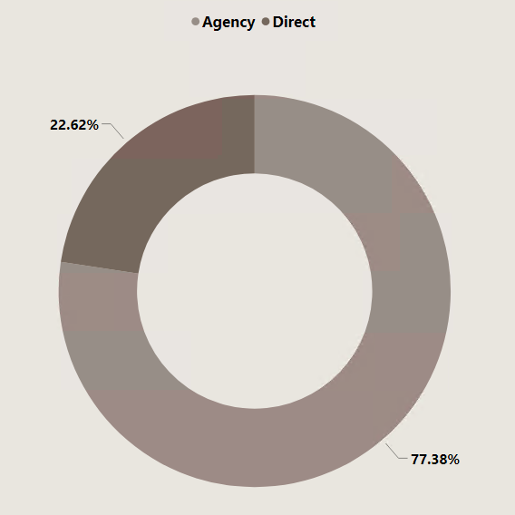
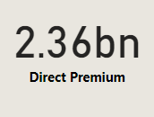
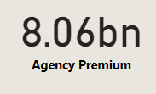
Earned premium by channel

Slide 7
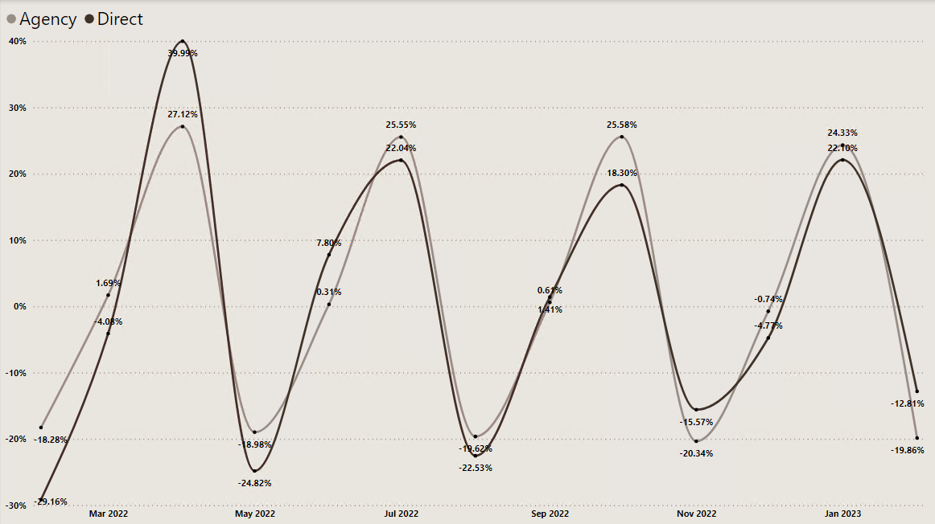
Earned premium growth percentage

Slide 8
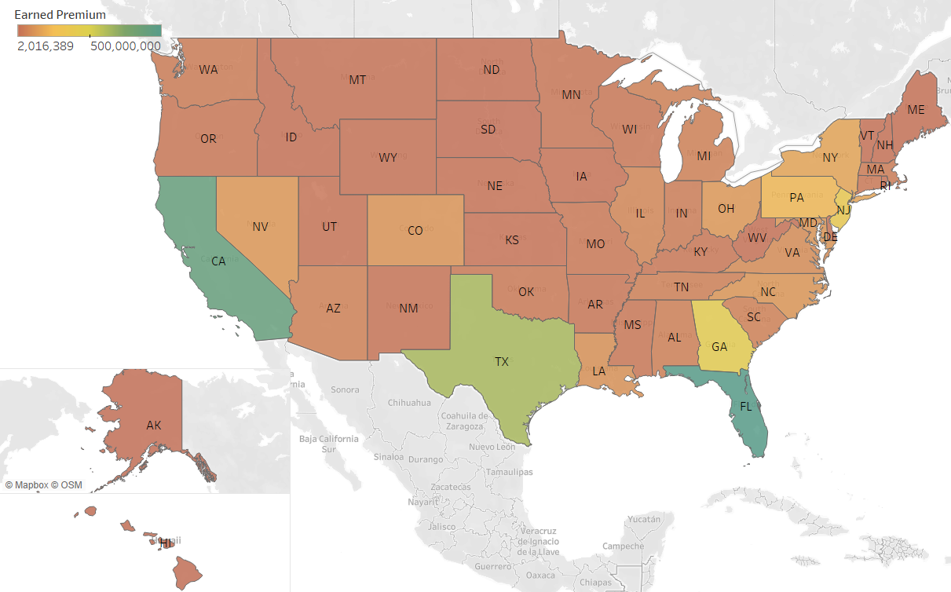
Direct channel earned premium
TOP 5 DIRECT STATES
1. FLORIDA
2. TEXAS
3. CALIFORNIA
4. NEW JERSEY
5. GEORGIA

Slide 9
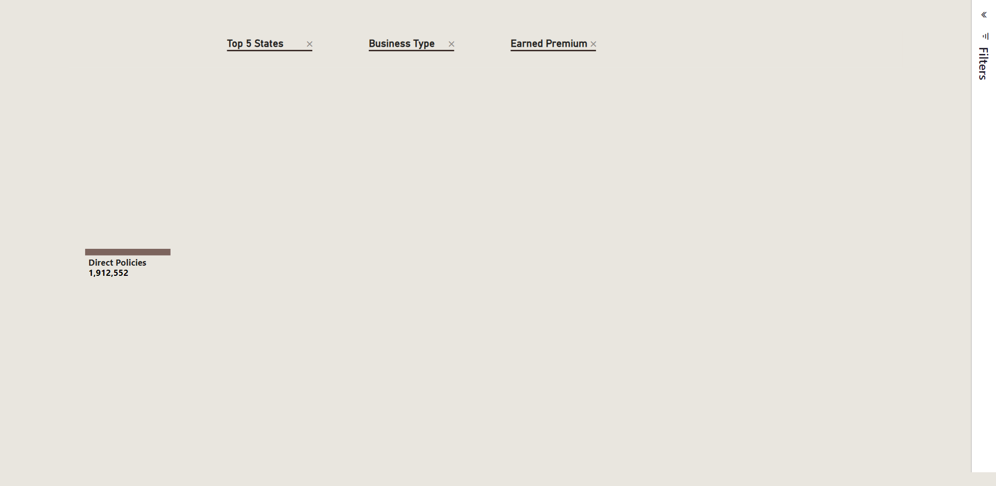
Direct tree

Slide 10
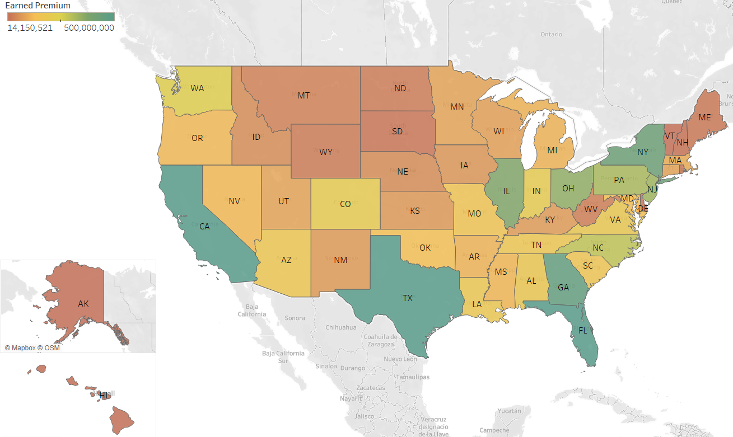
Agency channel earned premium
TOP 5 AGENCY STATES
1. TEXAS
2. FLORIDA
3. CALIFORNIA
4. NEW YORK
5. GEORGIA

Slide 11
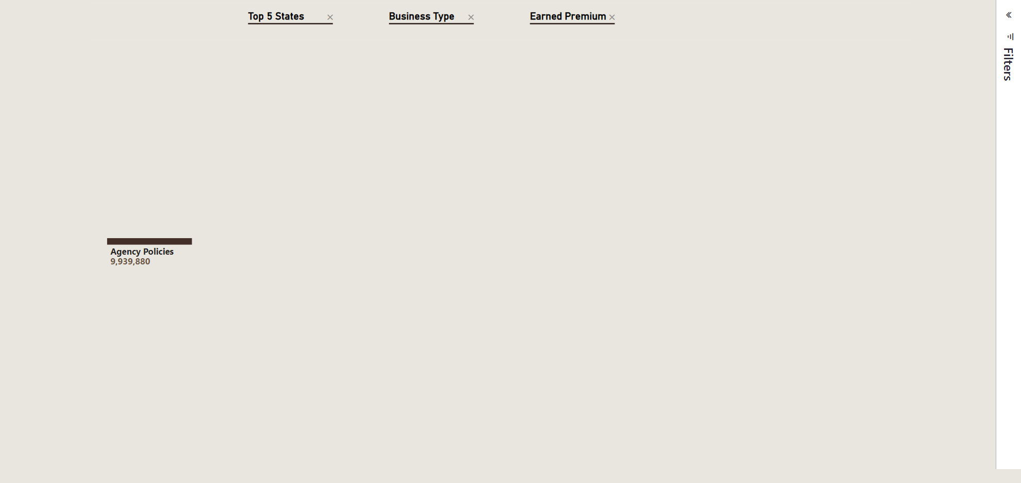
AGENCY TREE

Slide 12

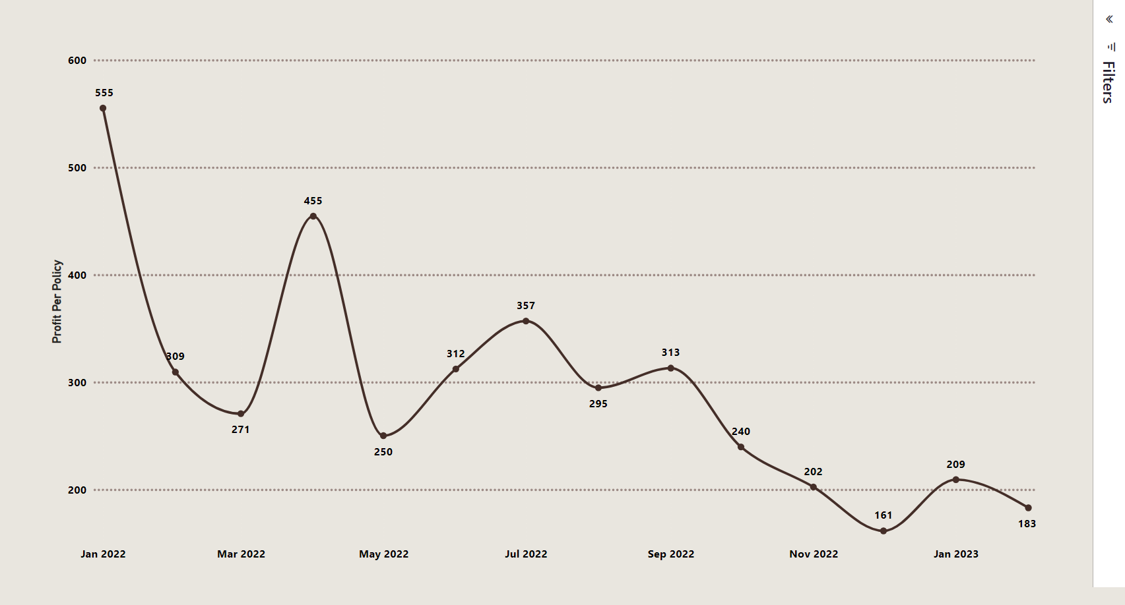
Direct profit per policy
(Earned premium-(loss-salvage))

Slide 13
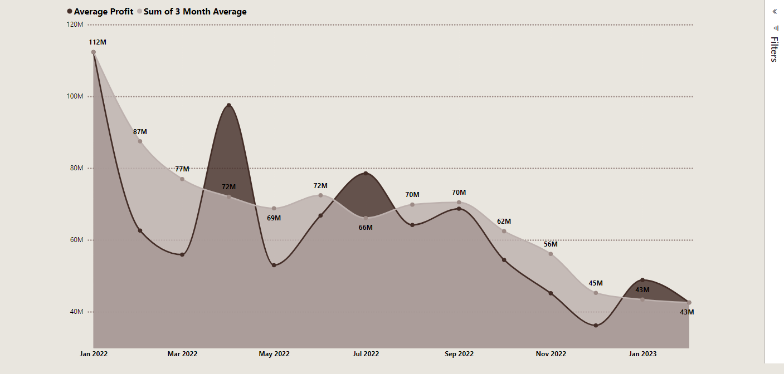
Direct Profit and 3 Month Moving Average

Slide 14
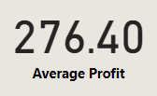
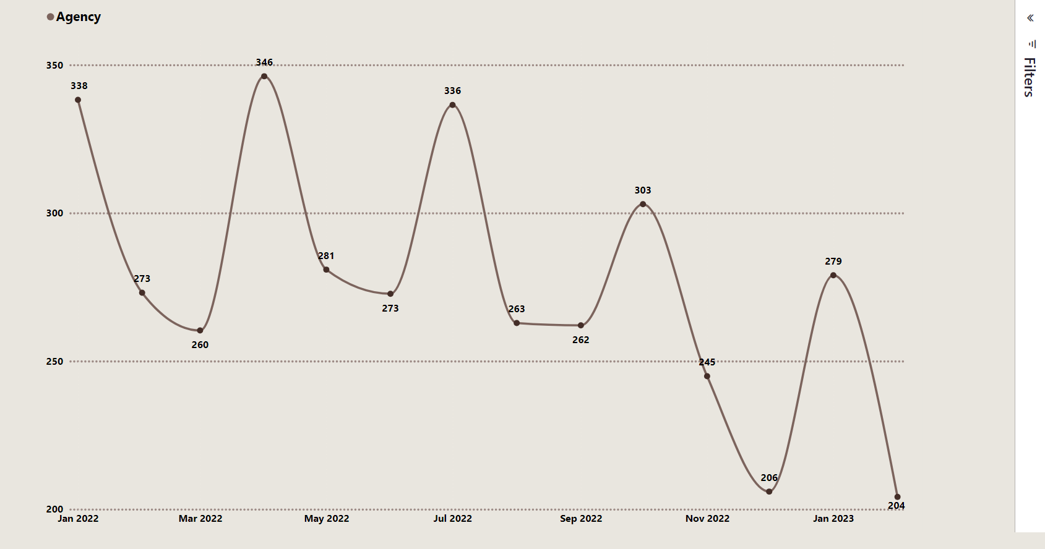
Agency profit per policy
(Earned premium-(loss-salvage))

Slide 15
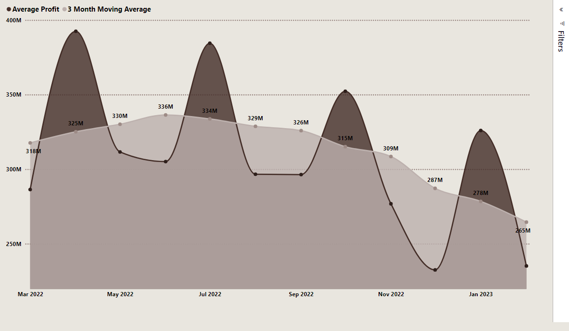
Agency profit and 3 month moving average

Slide 16
Growth opportunities
WISCONSIN
  REFRIGERATED GOODS, DIRT SAND & GRAVEL, AGRICULTURAL SERVICES, TOWING
MINNESOTA
  FOR HIRE TRUCKING, AUTO HAULERS, AGRICULTURAL HAULING, REFRIGERATED GOODS
KENTUCKY
  FOR HIRE TRUCKING, LOGGING, TOWING, EXPEDITERS
MICHIGAN
  FOR HIRE TRUCKING, EXPEDITERS, DIRT SAND & GRAVEL, AUTO HAULERS, STEEL HAULING
MASSACHUSETTS
  FOR HIRE TRUCKING, RESIDENTIAL BUILDERS, LANDSCAPING

Slide 17
THANK YOU!

